Slide 1


Angular Nights
[Forms and APIs]
June 7, 2019

Slide 2
Thanks to
our
venue
sponsor:
The ever supportive company to all tech-communities. Salamat!

Slide 3
Let’s Start

Slide 4
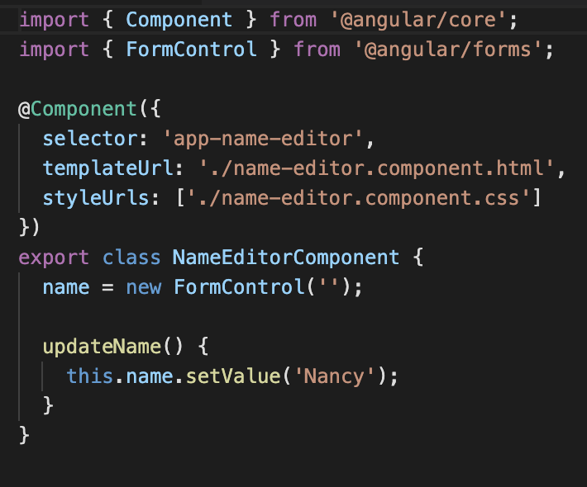
Reactive Forms
Reactive forms provide a model-driven approach to handling form inputs whose values change over time.
Reactive forms use an explicit and immutable approach to managing the state of a form at a given point in time.
Each change to the form state returns a new state, which maintains the integrity of the model between changes

Slide 5
TUT101: Using Reactive Forms
Step 1: Registering the reactive forms module
Step 2: Generating and importing a new form control
Step 3: Registering the control in the template

Slide 6
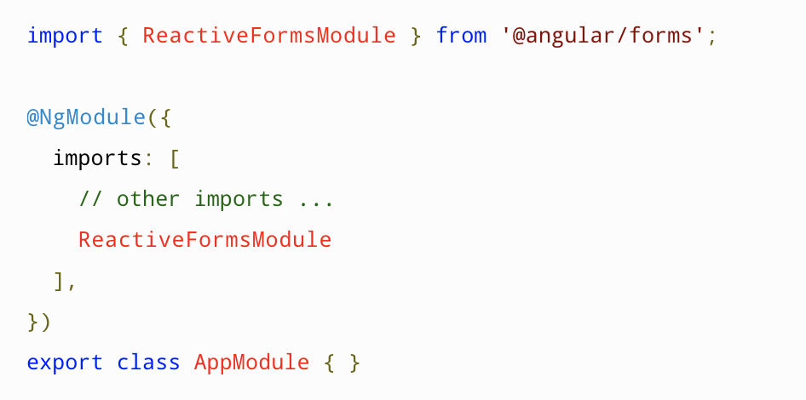
Step 1: Registering the reactive forms module

Slide 7
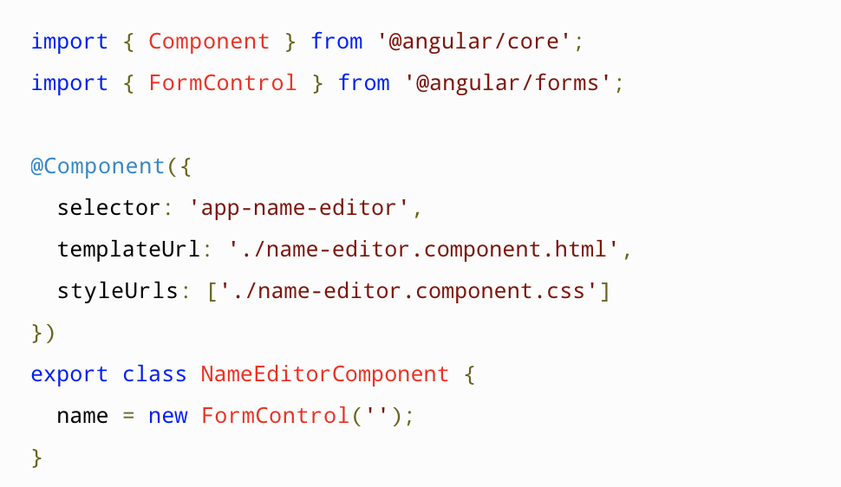
Step 2: Generating and importing a new form control

Slide 8
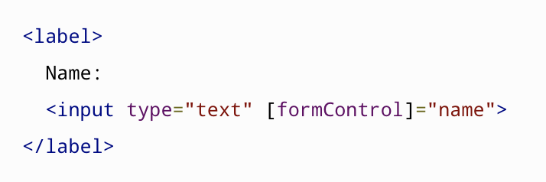
Step 3: Registering the control in the template

Slide 9
But what if I want to group my form? Can I do that?
Of course my child! We can use the FormGroup for that!
- Just as a form control instance gives you control over a single input field, a form group instance tracks the form state of a group of form control instances. Each control in a form group instance is tracked by name when creating the form group.

Slide 10
But what if I want to group my form? Can I do that?
Of course my child! We can use the FormGroup for that!
- Just as a form control instance gives you control over a single input field, a form group instance tracks the form state of a group of form control instances. Each control in a form group instance is tracked by name when creating the form group.

Slide 11
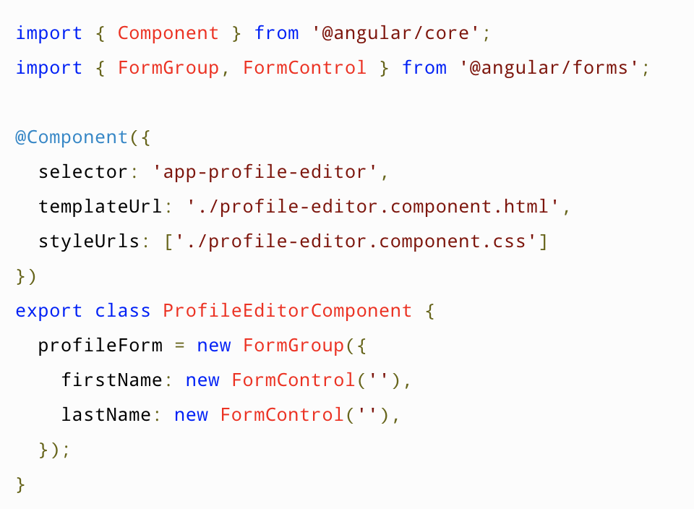
Example:

Slide 12
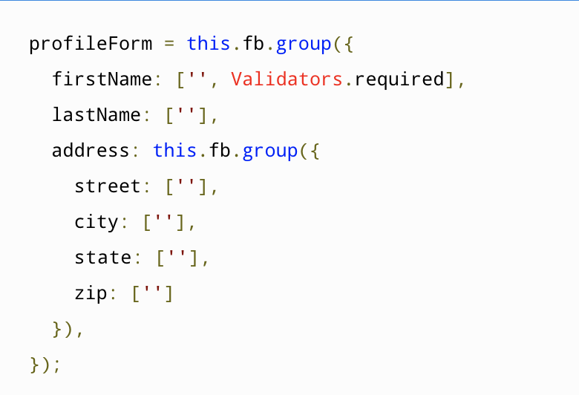
Can we add validations with Reactive Forms?
Short answer: Yes! By using Validators
- Example:

Slide 13
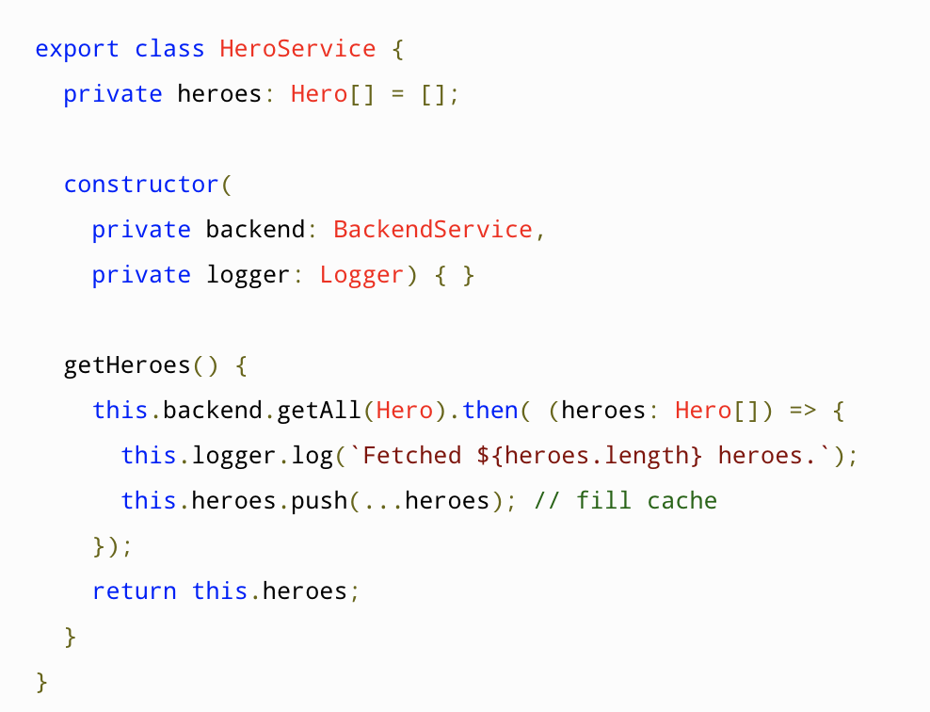
Services
Why should we use a service?
- Angular is built to provide a way to present data from a service
What is a service?
- A service is typically a class with a narrow, well-defined purpose. It should do something specific and do it well.
- Angular uses the service for anything including API consumption

Slide 14
TUT101: Creating Services
Step 1: Create a service component
Step 2: Provide the service to your App
Step 3: Implement functions to your service
Step 4: Use it on your component

Slide 15
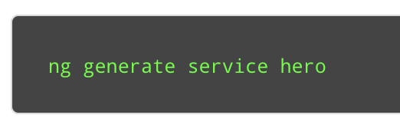
Step 1: Create a service component

Slide 16
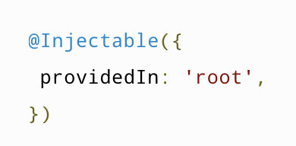
Step 2: Provide the service to your App

Slide 17
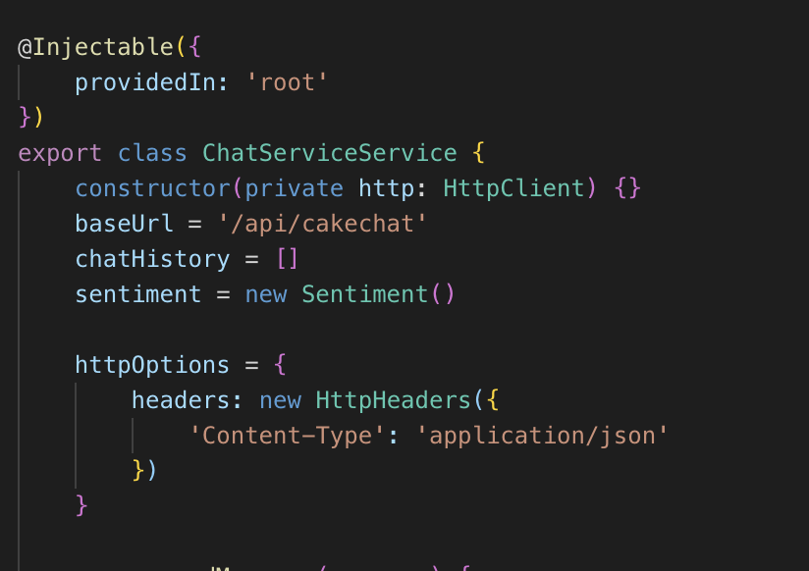
Step 3: Implement functions to your service

Slide 18
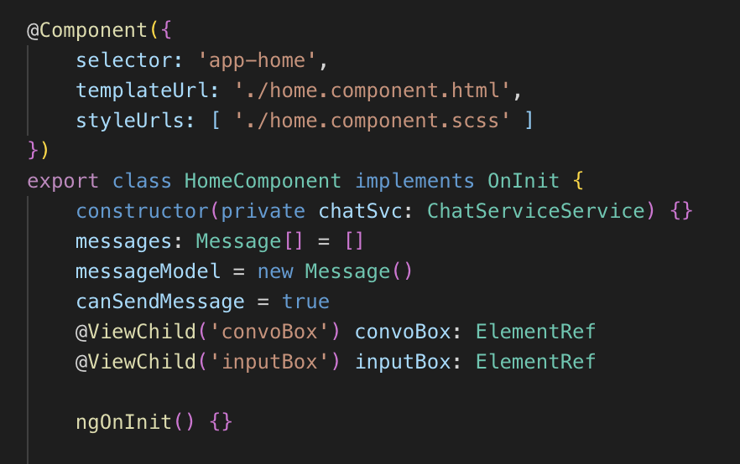
Step 4: Use it on your component

